Slide 1
Lecture #18
SOFT COMPUTING
INT508

Slide 2
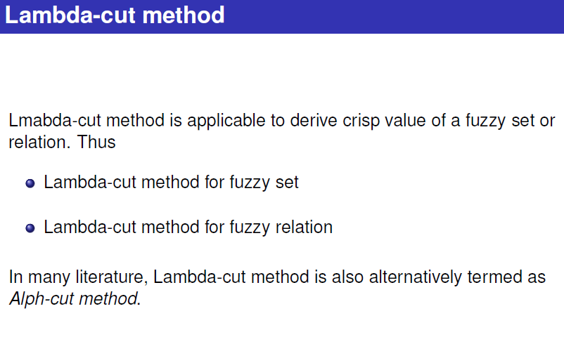

Slide 3
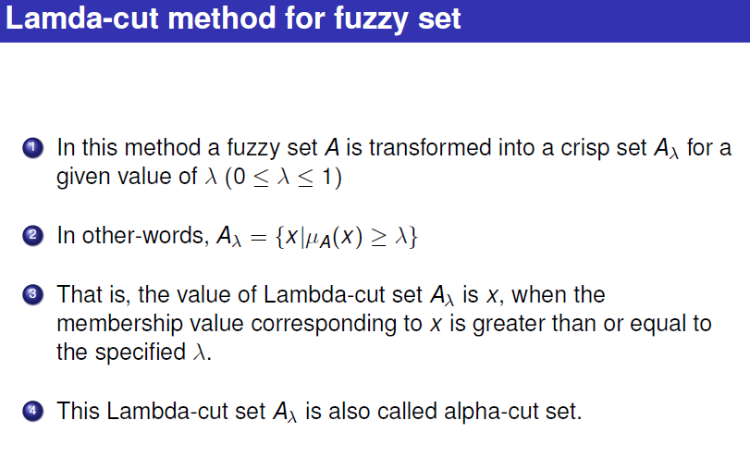

Slide 4
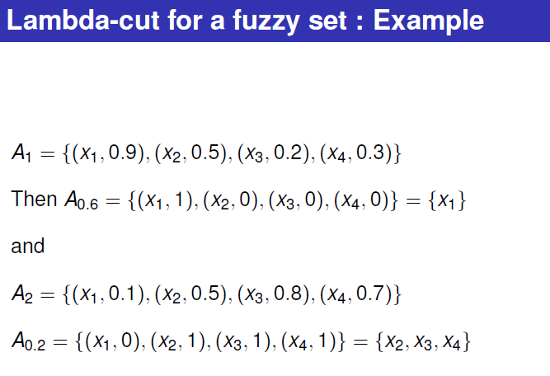

Slide 5
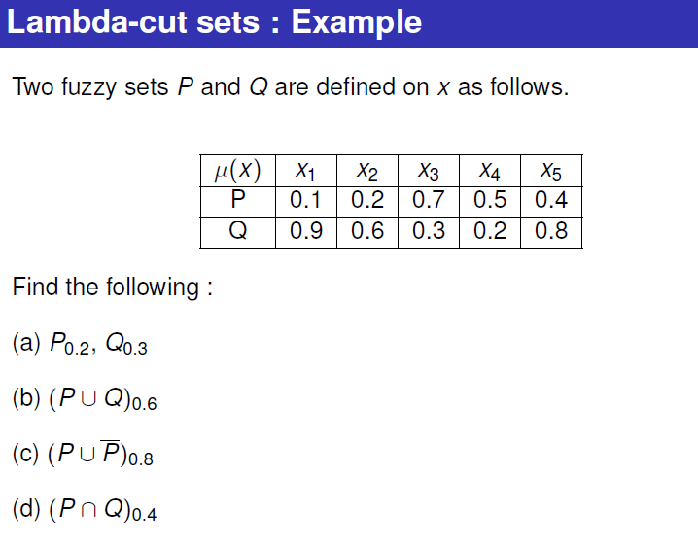

Slide 6
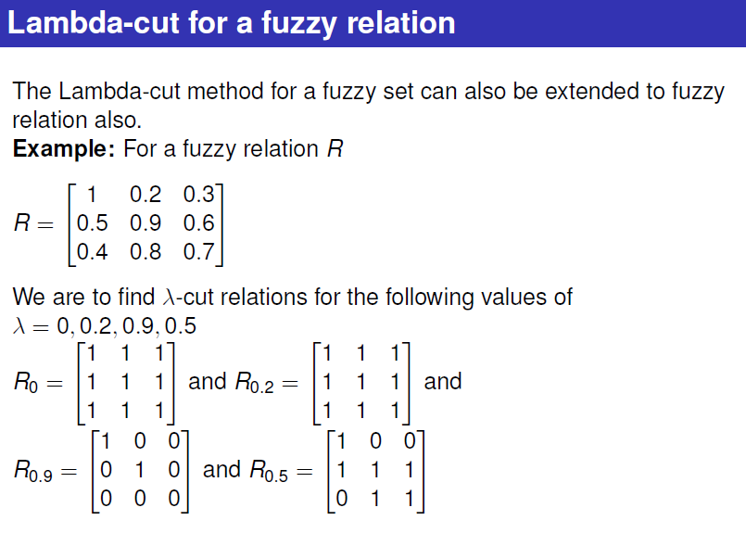

Slide 7
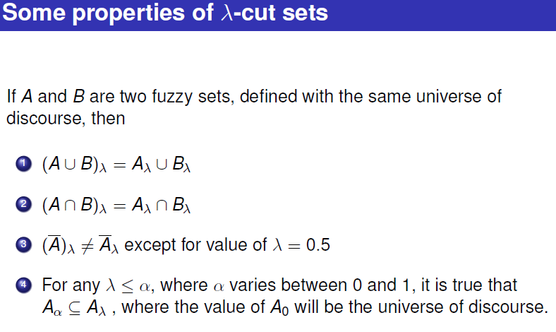

Slide 8
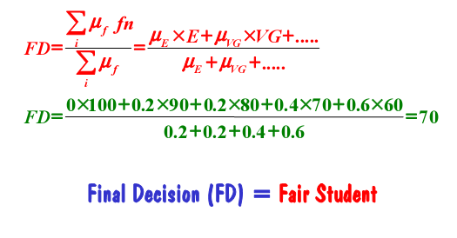
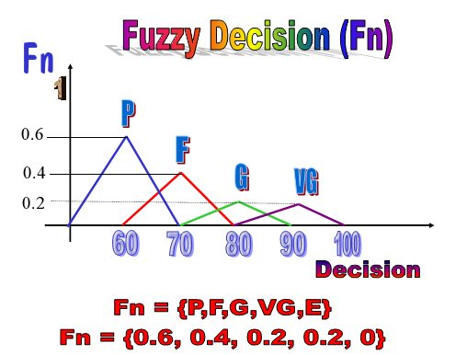
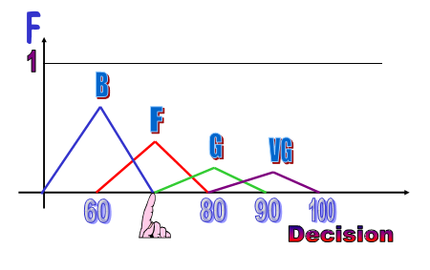
WEIGHTED AVERAGE METHOD

Slide 9
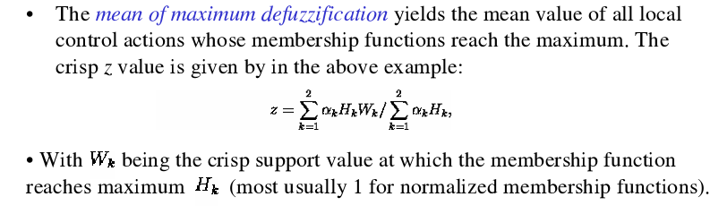
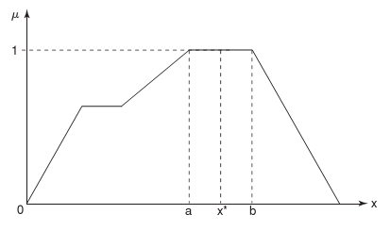

MEAN MAX MEMBERSHIP METHOD

Slide 10
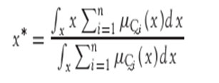
CENTER OF SUMS
This method employs the algebraic sum of the individual fuzzy subsets instead of their unions.
The calculations here are very fast but the main drawback is that the intersecting areas are added twice.
The defuzzified value x* is given by

Slide 11


CENTER OF LARGEST AREA
This method can be adopted when the output consists of at least two convex fuzzy subsets which are not overlapping. The output in this case is biased towards a side of one membership function. When output fuzzy set has at least two convex regions then the center-of-gravity of the convex fuzzy subregion having the largest area is used to obtain the defuzzified value x*. This value is given by
where is the convex subregion that has the largest area making up

Slide 12
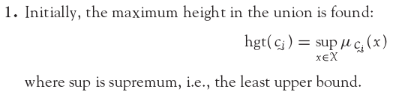
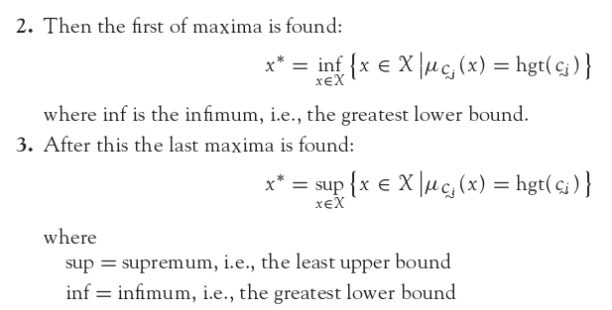
FIRST OF MAXIMA (LAST OF MAXIMA)
The steps used for obtaining crisp values are as follows:

Slide 13
FUZZY RULES AND REASONING
  The degree of an element in a fuzzy set corresponds to the truth value of a proposition in fuzzy logic systems.
A fuzzy rule is defined as the conditional statement of the form
If x is A
THEN y is B
where x and y are linguistic variables and A and B are linguistic values determined by fuzzy sets on the universes of discourse X and Y.

Slide 14
The decision-making process is based on rules with sentence conjunctives AND, OR and ALSO.
Each rule corresponds to a fuzzy relation.
Rules belong to a rule base.
Example: If (Distance x to second car is SMALL) OR (Distance y to obstacle is CLOSE) AND (speed v is HIGH) THEN (perform LARGE correction to steering angle θ) ALSO (make MEDIUM reduction in speed v).
Three antecedents (or premises) in this example give rise to two outputs (consequences).

Slide 15
FUZZY RULE FORMATION
IF height is tall
THEN weight is heavy.
Here the fuzzy classes height and weight have a given range (i.e., the universe of discourse).
range (height) = [140, 220]
range (weight) = [50, 250]
Three general forms are adopted for forming fuzzy rules. They are:
Assignment statements,
Conditional statements,
Unconditional statements.

Slide 16
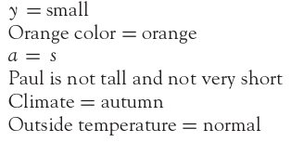
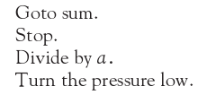

Assignment Statements
Unconditional Statements
Conditional Statements

Slide 17
DECOMPOSITION OF FUZZY RULES
A compound rule is a collection of several simple rules combined together.
Multiple conjunctive antecedent,
Multiple disjunctive antecedent,
Conditional statements (with ELSE and UNLESS).

Slide 18
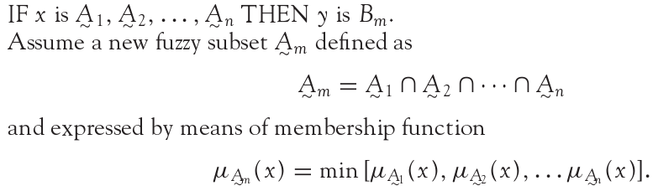
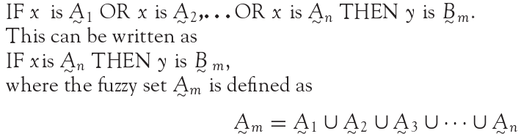
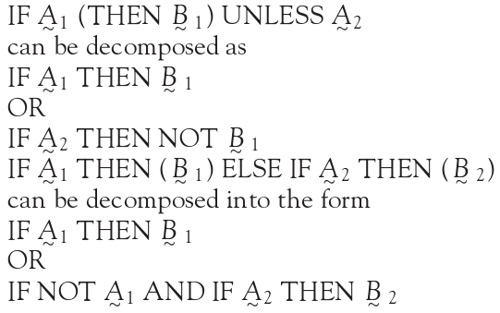
DECOMPOSITION OF FUZZY RULES
Multiple Conjunctive
Antecedants
Multiple disjunctive
antecedent
Conditional Statements ( With Else and Unless)

Slide 19
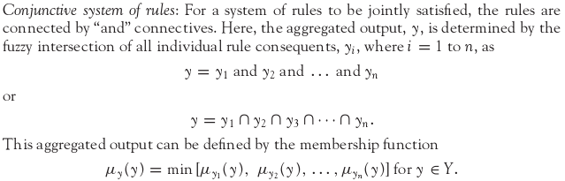
AGGREGATION OF FUZZY RULES
Aggregation of rules is the process of obtaining the overall consequents from the individual consequents provided by each rule.
Conjunctive system of rules.
Disjunctive system of rules.

Slide 20
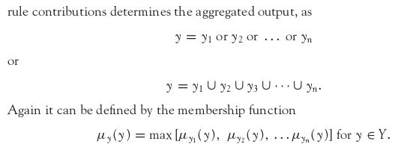
Disjunctive system of rules

Slide 21
FUZZY RULE - EXAMPLE
Rule 1: If height is short then weight is light.
Rule 2: If height is medium then weight is medium.
Rule 3: If height is tall then weight is heavy.
Problem: Given
(a) membership functions for short, medium-height, tall, light, medium-weight and heavy;
(b) The three fuzzy rules;
the fact that John’s height is 6’1”
estimate John’s weight.

Slide 22
Solution:
(1) From John’s height we know that
John is short (degree 0.3)
John is of medium height (degree 0.6).
John is tall (degree 0.2).
(2) Each rule produces a fuzzy set as output by truncating the consequent membership function at the value of the antecedent membership.

Slide 23
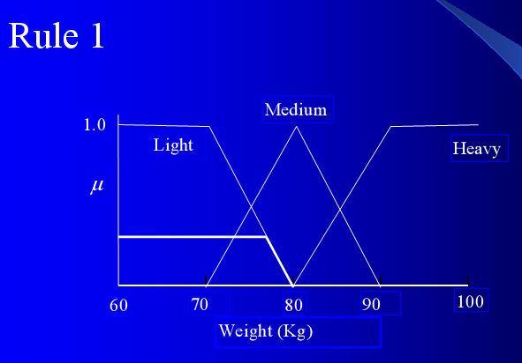

Slide 24
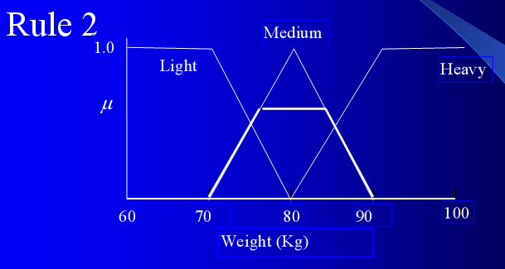

Slide 25
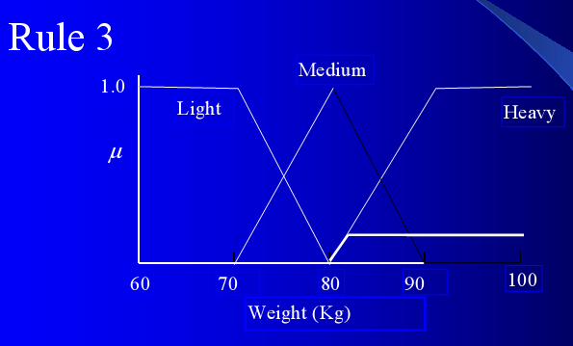

Slide 26
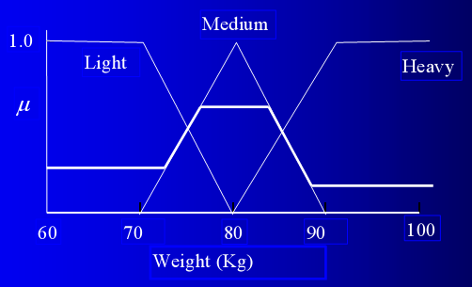
The cumulative fuzzy output is obtained by OR-ing the output from each rule.
Cumulative fuzzy output (weight at 6’1”).

Slide 27
De-fuzzify to obtain a numerical estimate of the output.
Choose the middle of the range where the truth value is maximum.
John’s weight = 80 Kg.

Slide 28

12/12/14
CSE510, Lovely Professional University, Phagwara

